Slide 1
INTRODUCTION TO THEORETICAL COMPUTER SCIENCE
CSC 304
Professor Lucci
Lecture 1

Slide 2
Theory of Computation
Focuses on the theoretical underpinnings of software construction

Slide 3
Fundamental Question 1
What is an algorithm?
A finite set of instructions to solve a problem
It generally has inputs and outputs
It must be guaranteed to halt
NOTE: If there is no guarantee to halt, it is a procedure.

Slide 4
Examples
What are some examples of algorithms?
What are some examples of procedures?

Slide 5
Algorithms
Define algorithm primitives:
fundamental steps that are clearly understood
An algorithm for:
Making a phone call
Cooking penne a la vodka
Making an origami bird
What are the primitives here?

Slide 6
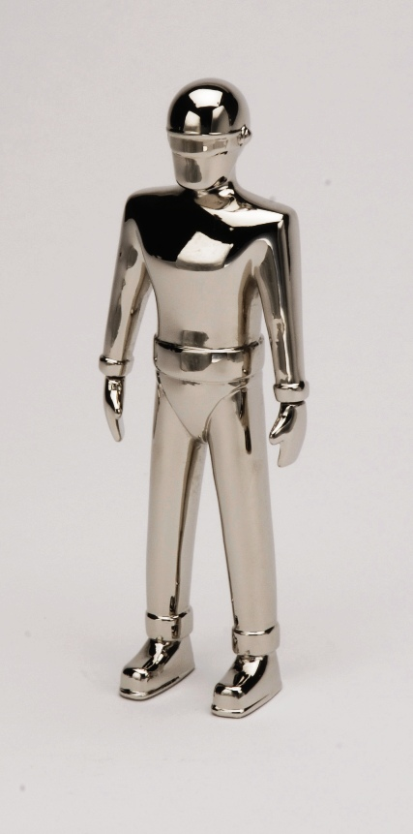
Fundamental Question 2
What is a program?
A program is an algorithm that is written in some programming language (e.g. C++, Java, )…
BUT computers do not “speak” C++ or Java…

Slide 7
How Do We Translate?
Program in high level language (HLL)
Source program
Compiler System
(software)
Program translated into machine language object code

Slide 8
Fundamental Question 3
What is a computer?
Take a moment to think on this one!

Slide 9
Solvable vs. Unsolvable Problem
Unsolvable Problem:
An answer can never be forthcoming- No matter how much time is permitted!
Decision Problem:
The answer is YES or NO

Slide 10
Given an arbitrary program P running on an arbitrary input ω, will P halt?
Decision form of the question - Yes or No answer
Given a super program SP which returns
Yes if P(ω) = halt
No, otherwise
**When problems are solvable - we wish to know if they are easy or hard.

Slide 11
A problem is said to tractable if:
easy
there exists an algorithm A to solve the problem whose worst case is polynomial. i.e., polynomial in the size of problem (n)
Examples?

Slide 12
A problem is said to be intractable if:
hard
the only algorithms that exist to solve the problem require worse than polynomial time (i.e., Super-polynomial)
Super polynomial - exponential time : 2^{n}, n^{n}, factorial: n!
Examples of Intractable Problems?

Slide 13
Abstract Model of a Computer
In this course we look for an abstract (mathematical) model of a computer.
WHY?

Slide 14
Abstract Model of a Computer
We require that this model be a Reasonable Model of Computation
The amount of pre-recorded facts is finite.
In one computation step, only a finite amount of computation is permitted
Ex: 127 //multiplicand
x 14 //multiplier
508 //partial products
127
1778 //product

Slide 15
Parts of Processing
Arithmetic Logic Unit (ALU):
Actual execution of instructions (Ex: Add, Multiply, Shift)
Control Unit (CU):
Sequencing, Timing, Decoding of Instructions
Machine Computation:
SISD Model – Single Instruction/ Single Data Stream Computer. Von Neumann Model of Computation. Responsible for concept of stored program.
SIMD
MISD
MIMD

Slide 16
Parts of Processing
Central Processing Unit (CPU)
CU -> ALU
-Sends data to MU
Memory Unit
-Sends Instructions an Data back to CPU
-Interacts with I/S
Input/output
I/O Interference
-Interacts with Memory Unit

Slide 17
Computation Model
Von Neumann Model of Computation:
Responsible for stored program concept (SISD)
Alan Turing (1936):
Later in the course we will encounter other Turing machines as well -
Multi-tape, Two- dimensional, etc.

Slide 18
Some Notation
S_{i} = current state
T_{J} = symbol on tape
S_{k} = New State
O_{l} =a move L or R, OR a write
**In our text we cannot “walk and talk at the same time”
B = Blank Symbol
Other texts use: #, b, etc.

Slide 19
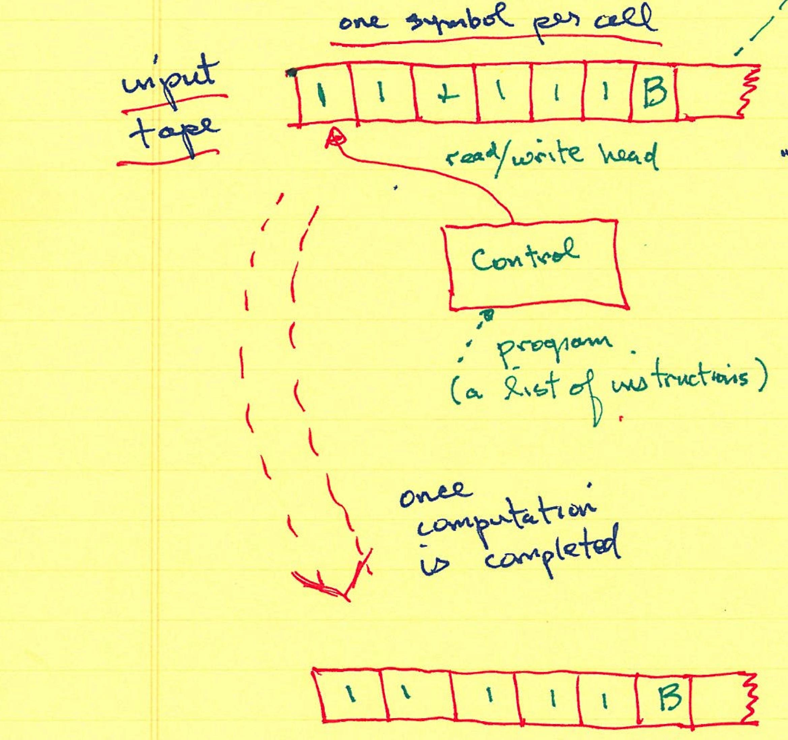
Turing Machine Example
Note: This is both the input tape and the output tape. The tape is unbounded.
//unary representation. ‘//’ is 2. “ruff, ruff”
<- machine halts at B.

Slide 20
Our Turing machines:
Come pre-loaded with B on every cell
Should halt on the leftmost B after the output string
PROBLEM:
A Turing machine for unary addition.
We will try together!

